Slide 1
Optimizing Delivery Efficiency & Reducing Customer Churn
The Data Decode Challenge 2026 by IISc(BLR)
Analysis by – Suprith S ( suprithshashidhara@gmail.com )

Slide 2
Executive Summary
Only 16% deliveries are on time
Most deliveries are getting delayed
Main reasons: weather, long distance, and wrong vehicle use
Delays are reducing customer ratings
Fixing delays can improve customer satisfaction and cost
Problem Statement
Deliveries are getting delayed
Customers are not satisfied
Costs are increasing
Need to find why this is happening and fix it

Slide 3
Methodology
Cleaned the data (fixed missing and wrong values)
Created new columns: Delivery Delay cost per km
Analyzed patterns in the data
Found reasons for delay
Tools used: Power BI & MS Excel

Slide 4
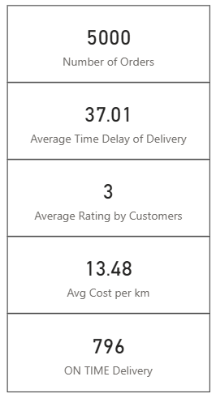
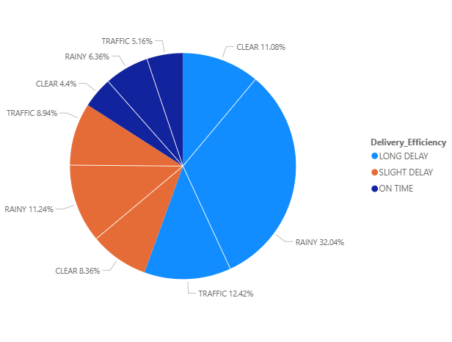
Delivery performance
Majority of the orders are delayed even when the whether and traffic is clear.

Slide 5
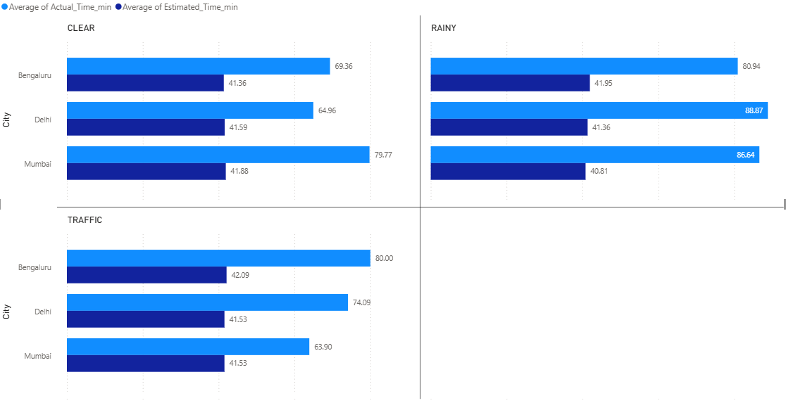
ETA Accuracy Analysis
Actual delivery time is consistently higher than estimated time
Indicates inaccurate prediction system
The company is over-promising and under-delivering

Slide 6
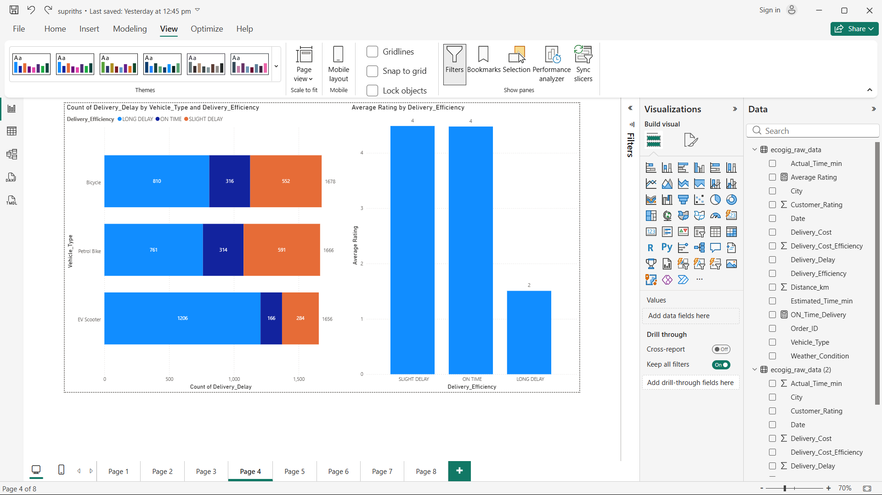
Customer Impact Analysis
On-time deliveries → Avg Rating: 4
Slight delays → Avg Rating: 4
Long delays → Avg Rating: 2
Key Insight:
Severe delays reduce customer ratings by ~50%
Delivery delay is the primary driver of customer dissatisfaction

Slide 7
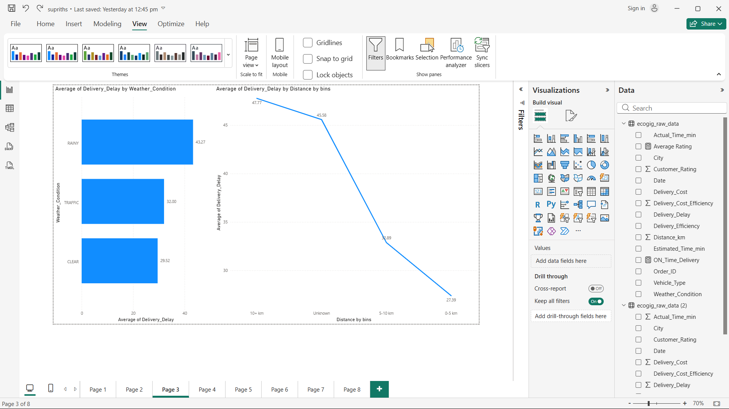
Root Cause – Weather Impact & Distance Impact
Clear weather → 29.5 min delay
Rain → 43.2 min delay
Traffic → 32 min delay
Key Insight:
Rain increases delays by ~45%, making it the most critical external factor

Slide 8
Root Cause – Weather Impact & Distance Impact
Majority of deliveries fall in medium to long distance categories
Long-distance deliveries show higher delays
Key Insight:
Delivery delays increase significantly as distance increases

Slide 9
Root Cause – Vehicle Inefficiency
Bike → 32.5 min delay
Cycle → 34.34 min delay
EV Scooter → 44.25 min delay
Key Insight:
EV scooters have the highest delay despite higher costs

Slide 10
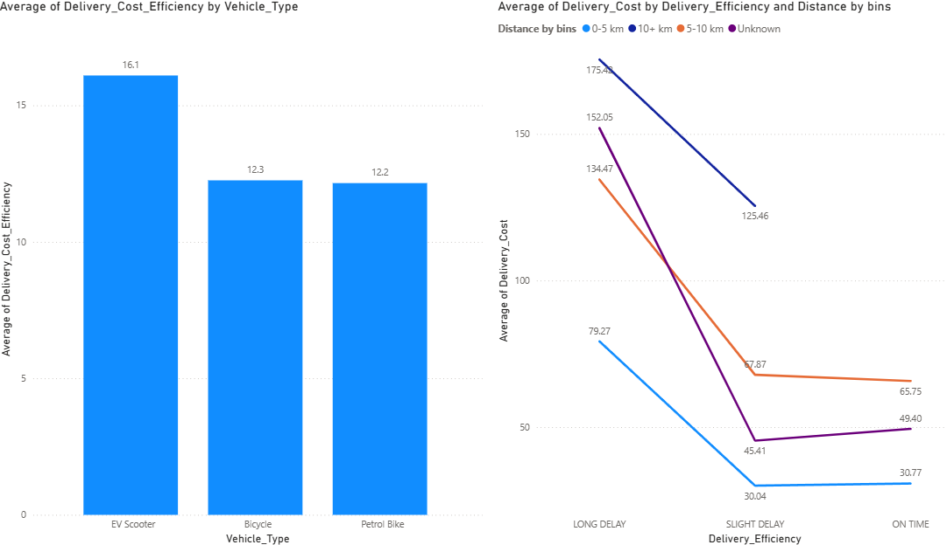
Cost & Operational Insights
Average Cost per km: ₹13.48
EV scooters have the highest cost and lowest efficiency
Delivery inefficiencies increase operational costs
Key Insight:
The most expensive vehicle is also the least efficient

Slide 11
Strategic Recommendations & Conclusion
Operational Optimization
Allocate vehicles based on distance and efficiency
ETA System Improvement
Implement dynamic ETA based on weather and distance
Weather-Based Adjustments
Add buffer time and increase fleet during adverse conditions
Customer Retention
Proactive delay communication and compensation
Final Conclusion:
Delivery inefficiencies are driven by systemic operational issues
Optimizing fleet allocation and improving ETA accuracy can significantly reduce delays, lower costs, and improve customer satisfaction

